Slide 1

Streaming Weather Data
By:-
Redon N Roy
Rushikesh Lavate
Meenal Shree
Nirosha M
Neha Kumari

Slide 2
Our Project
Our project deals with the processing of the data from www.weatherbit.io using Kafka and Spark Streaming .
Here we are simulating the streaming data using previous days data and visualizing the outcome using matplotlib. The data processing is developed using Python.

Slide 3
Table of Contents
01
02
03
PROBLEM & SOLUTION
CODE WALKTHROUGH
CONCLUSION
Going over the problem statement and presenting our solution
Explaining the code behind our solution and live demo
Discussing scope, future development and conclusion

Slide 4
PROBLEM & SOLUTION

Slide 5
Understanding the Problem
How to process raw stream data
Visualize the data at real-time
One of the problem we are addressing in this project is the processing of raw stream data coming from multiple sources and getting only the required data from it.
Another problem we will be addressing here is the vizualization of the processed data at near real-time to the user.

Slide 6

Our Solution
Data Source
Processing
Filtering
Visualizing
The stream data coming from the source
The raw data is filtered to make it structured and usable
Getting only the data that we to work on from the processed data
The filtered data is visualized at near real-time

Slide 7
Major Tech Stacks
Python
Spark Streaming
Kafka
Matplotlib
High level programming language
Processing real time data
Framework for event streaming data
For plotting graph

Slide 8
Getting the project up and running
Frist of all install all the tech stack for the project.
Then start the Zookeeper server using the zookeeper-server-start.bat file its configuration file.
Then start the Kafka server using the kafka-server-start.bat file its configuration file.
After that we will execute the producer program.
Once that’s done, do spark-submit of the consumer program.
In the end, run the output program.

Slide 9
Our Process
Data
Processing
STEP 02
STEP 04
STEP 01
STEP 03
Data ingestion
Graph Plotting
Searched for the data source and finalized on weather data from www.weatherbit.io
Integrated Kafka consumer and producer with spark streaming and decided the operations while debugging for the errors
Figured out how to use historical data and integrate Kafka producer while debugging for the errors
Decided on how to visualize the data and update it at intervals while debugging for the errors

Slide 10
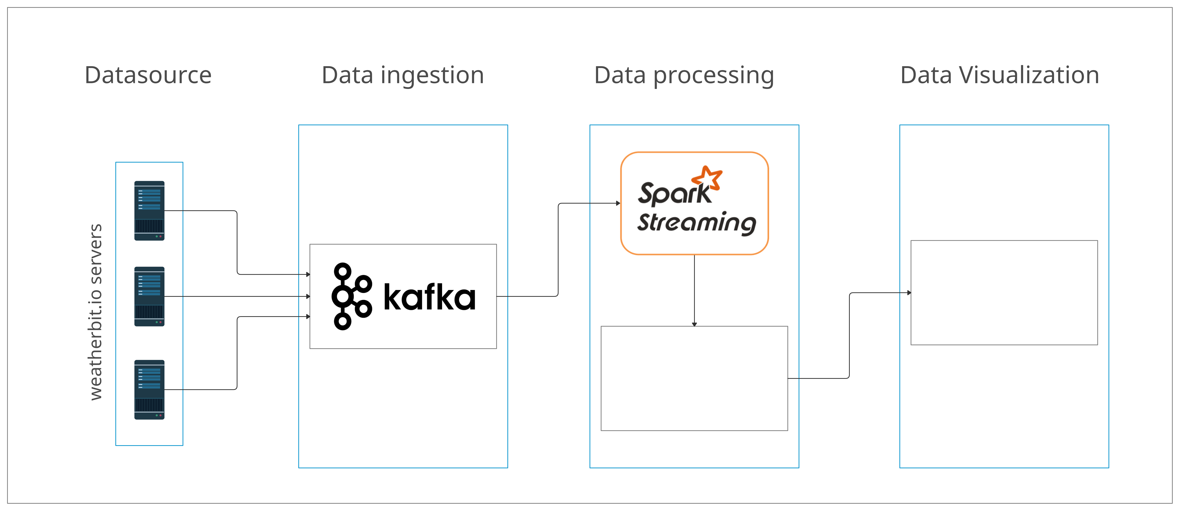
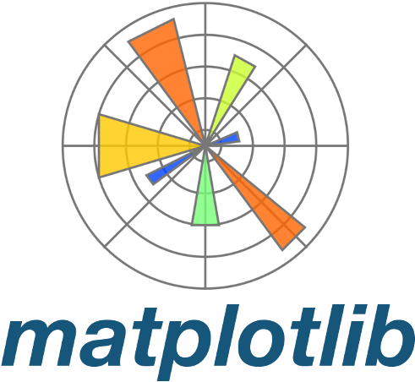

Working of the Project

Slide 11
CODE WALKTHROUGH

Slide 12
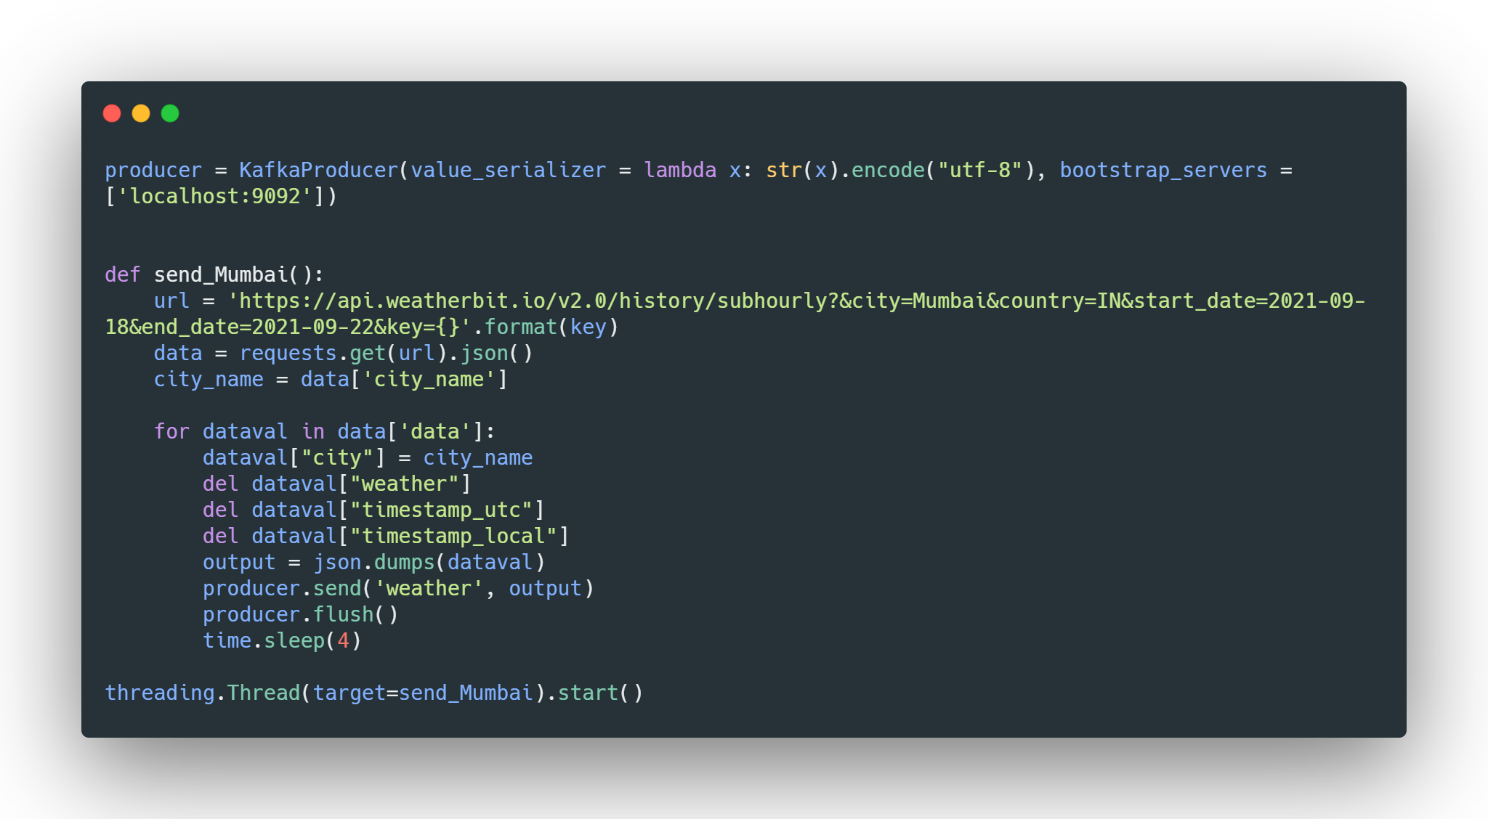
Data injestion and Publishing to Kafka Topic

Slide 13
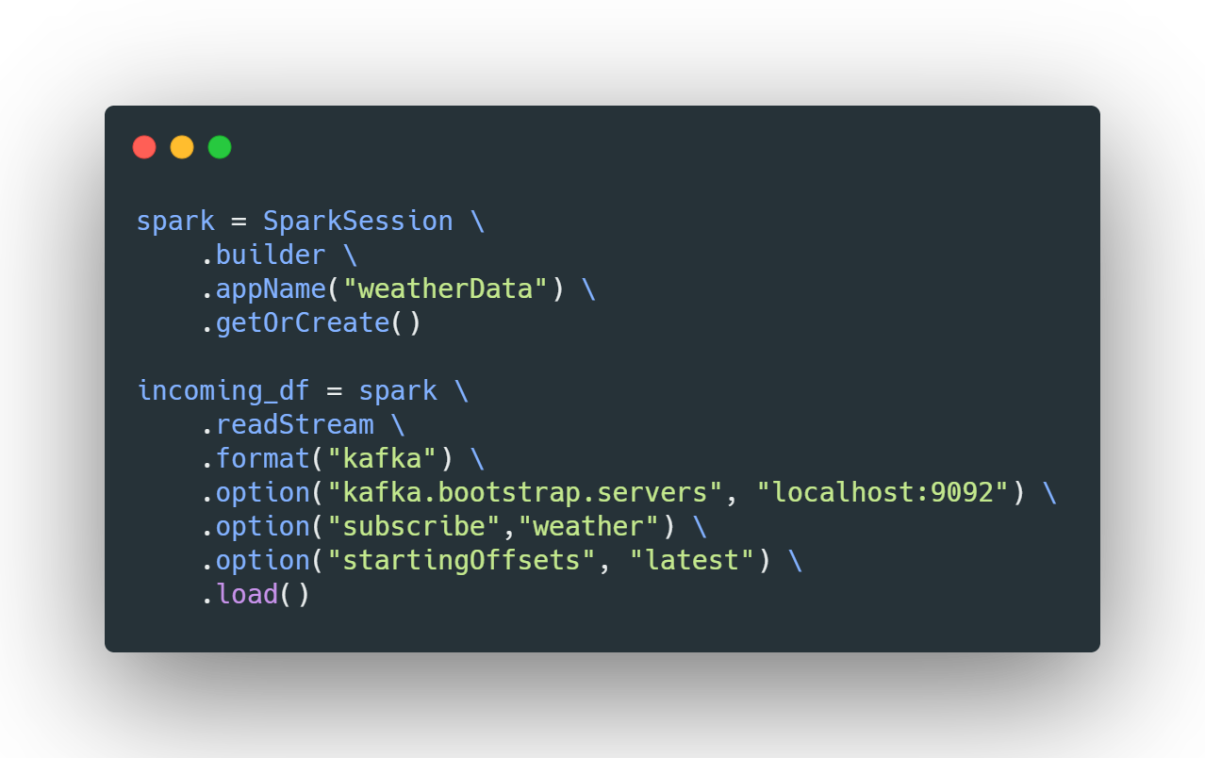
Creating Spark Session and consuming data from Kafka

Slide 14
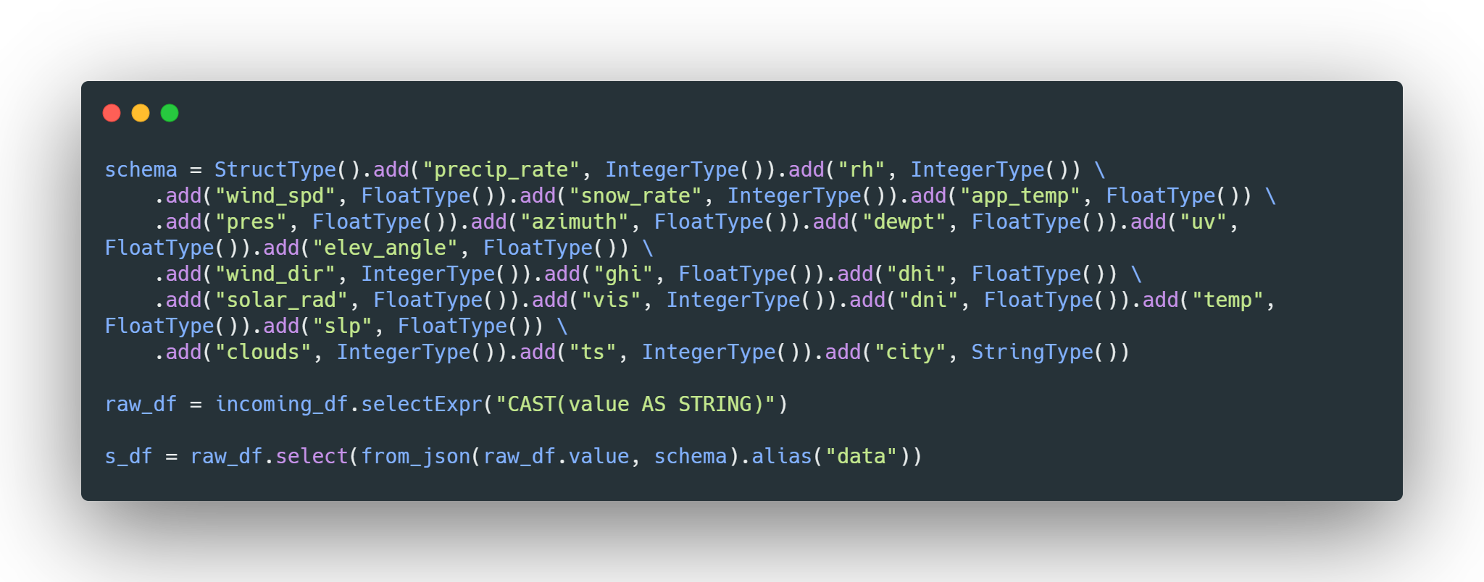
Converting raw data to structured data with schema

Slide 15
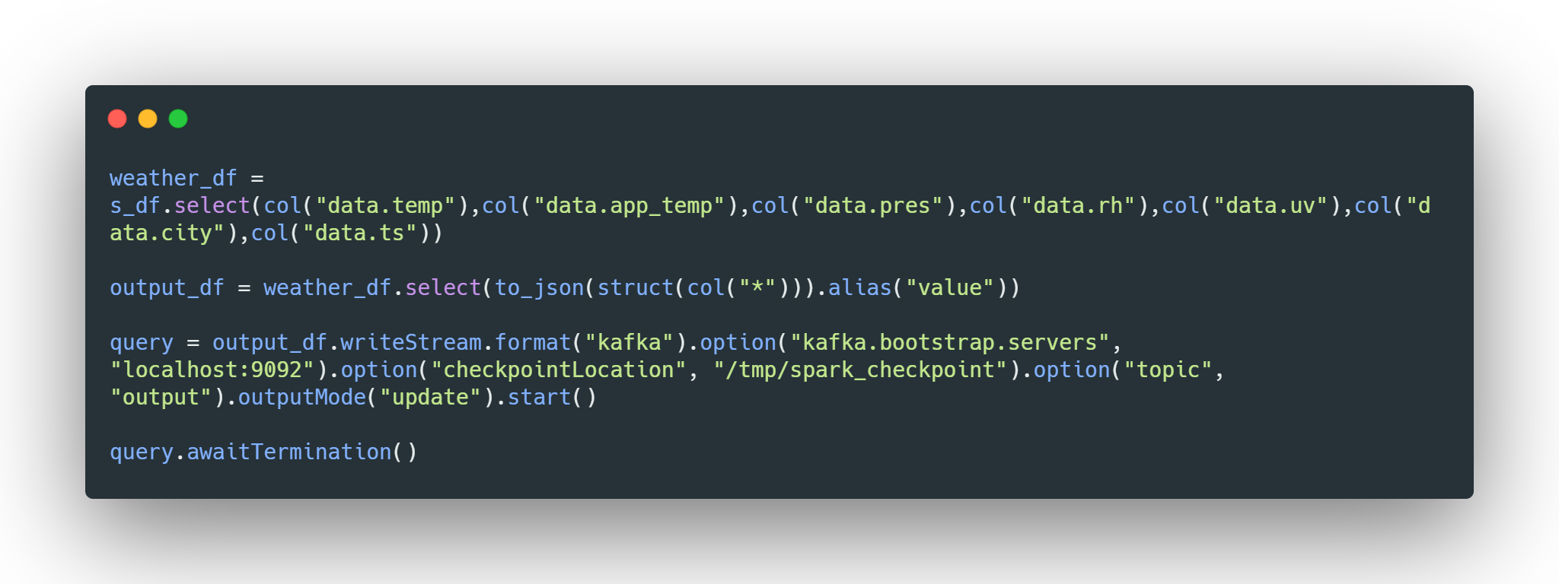
Filtering data and publishing output to kafka topic

Slide 16
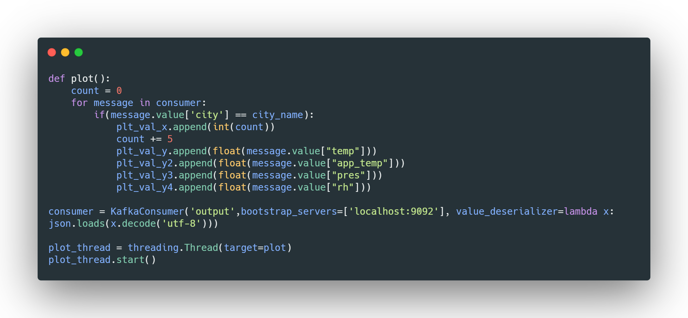
Consuming from Kafka topic and preparing data for plotting

Slide 17
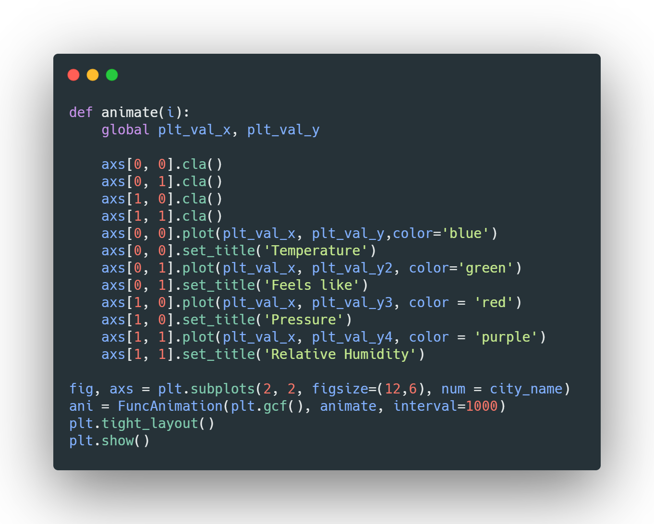
Plotting data as graph at near real-time with matplotlib

Slide 18
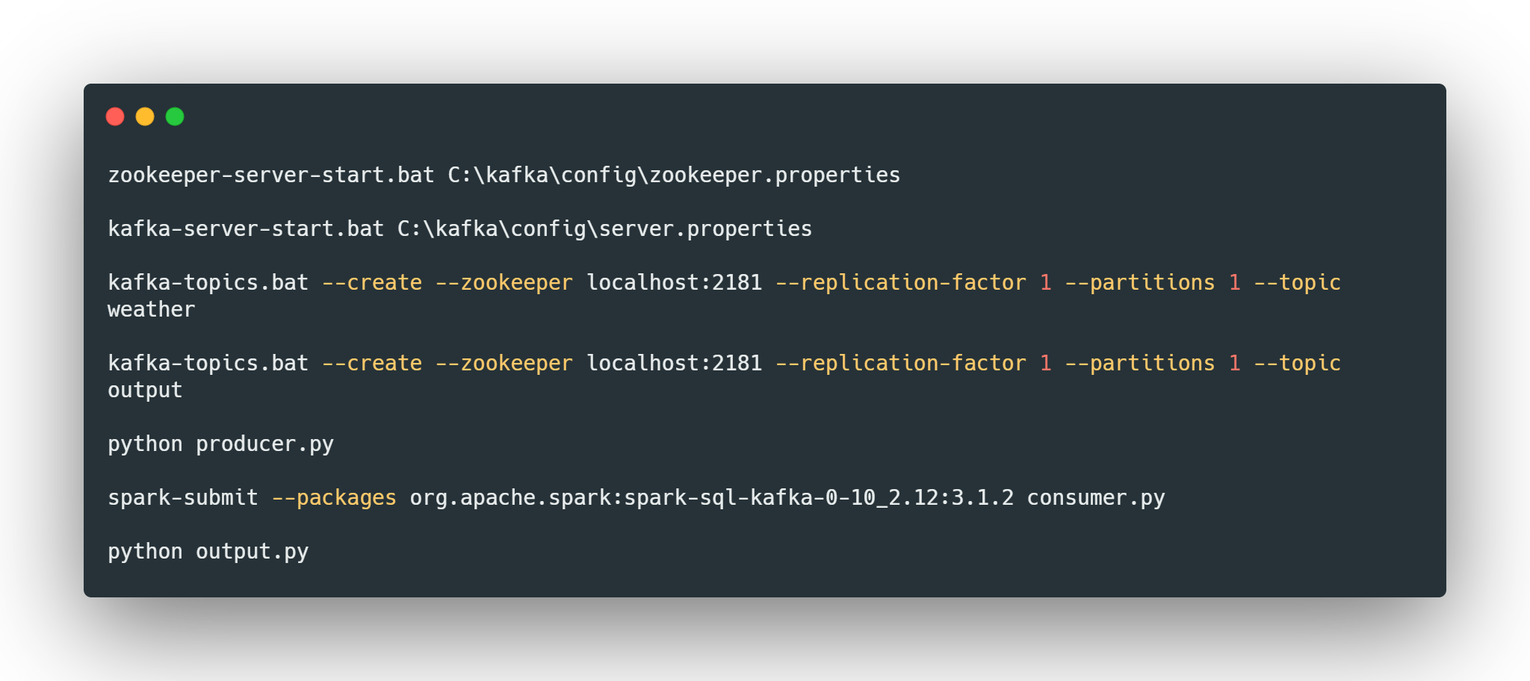
Prerequisites for running the project

Slide 19
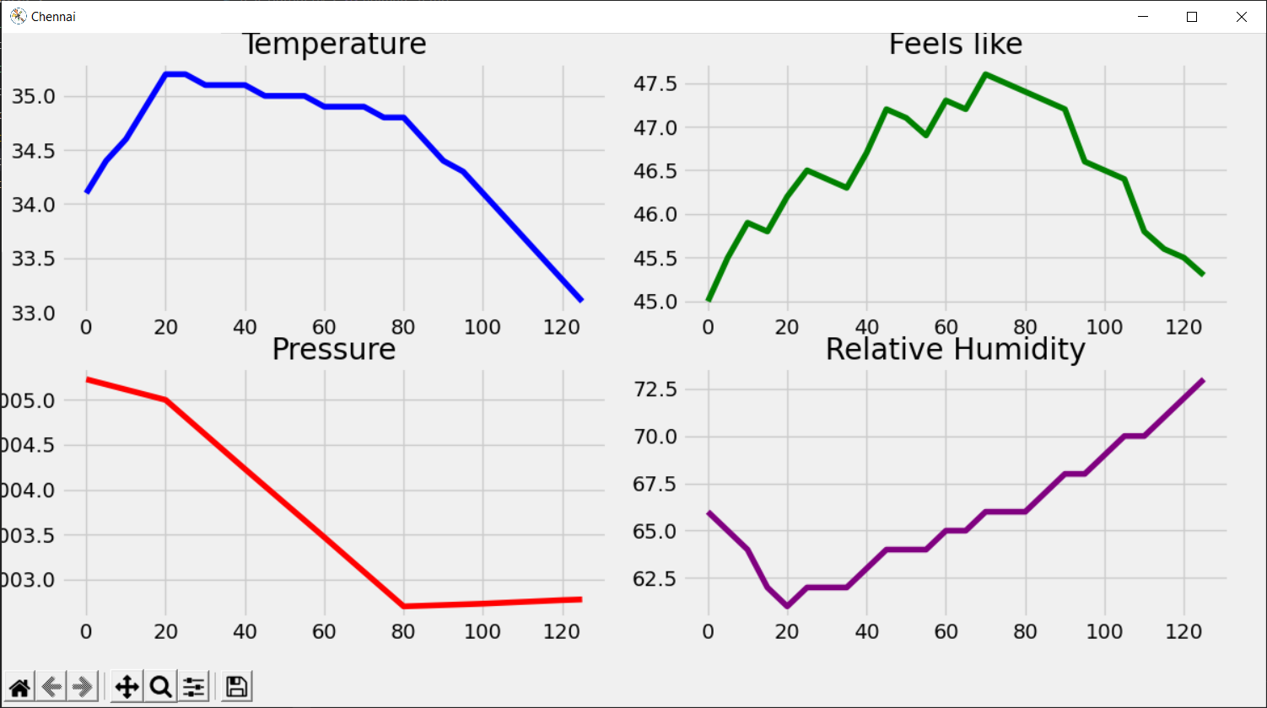
Output (Graph)

Slide 20
OUTCOMES & CONCLUSION

Slide 21

Challenges
Difficulties in finding the real time data source.
Faced problems while setting up the dependencies of the project like Kafka and Spark
Was unable to get the spark structure streaming to perform the operations in the proper way.
Spark submit failed due to missing package to integrate Kafka with Spark.
The graph was not visible while plotting .
The graph didn’t update with the real time data.

Slide 22
Scope
IoT Data
Other real time processing
We can use this project to process the stream data coming from IoT devices like sensors.
With minor modification we can use for processing real time data like stock market data

Slide 23
Future Developments
Change data source
Create dashboard
Change the data source to an actual real time data rather than simulation.
Create the dashboard to display the real time data.

Slide 24
Conclusion
The raw data can be inconsistent which cannot be used directly for processing. So we need to filter the raw data by applying the necessary operations on the raw data. This is were Spark Structured Streaming come into play which can help with processing of the raw data.
Displaying the processed data in near real-time is a task that can be achieved in multiple ways. The basic idea is to continuously listen to the incoming data and update the visualization accordingly. This is were the animation module of Matplotlib was used for real-time visualization.

Slide 25
Thank You !
https://github.com/redon-n-roy/Analyzing-real-time-data-with-spark-streaming-and-kafka

